Slide 1
Housing Price Prediction
Gloria Shen, Junfeng Li, Yuehai Shen

Slide 2
Topic & Objectives
We are predicting the housing sales price in California. In order to improve the accuracy of our prediction, we will only focus on the house price for sale.
Combining different data including housing price data, cities demographics data, and neighborhood reviews data.

Slide 3
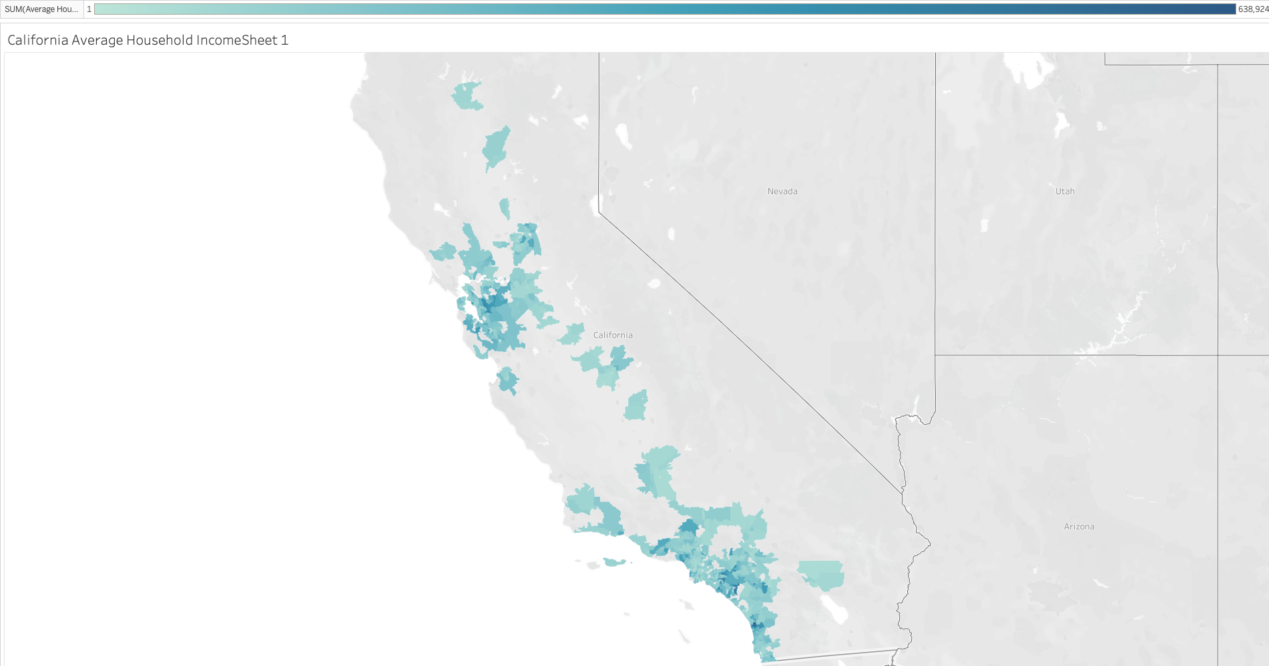
In order to reduce the variance and improve the accuracy of the study, We filter out the city with the top 150 population, this graph indicates the area included in the study. The color represent the average income of the area.

Slide 4
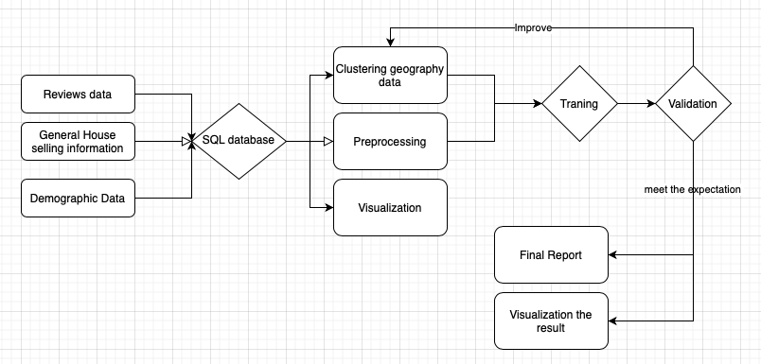
General Approach

Slide 5
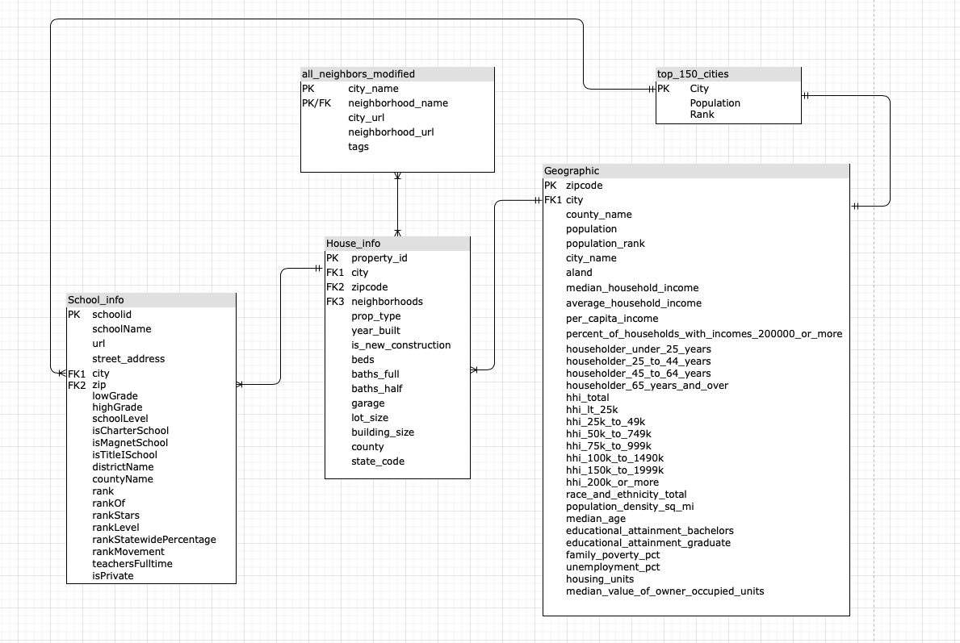
Datasets - ER Diagram

Slide 6
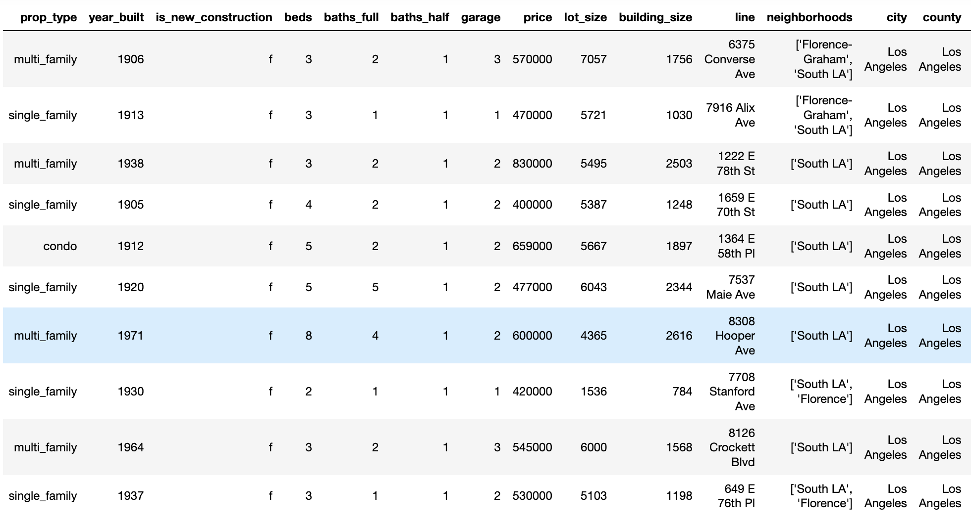
Datasets - General Housing Information
Data from Realtor API via rapidapi.com

Slide 7
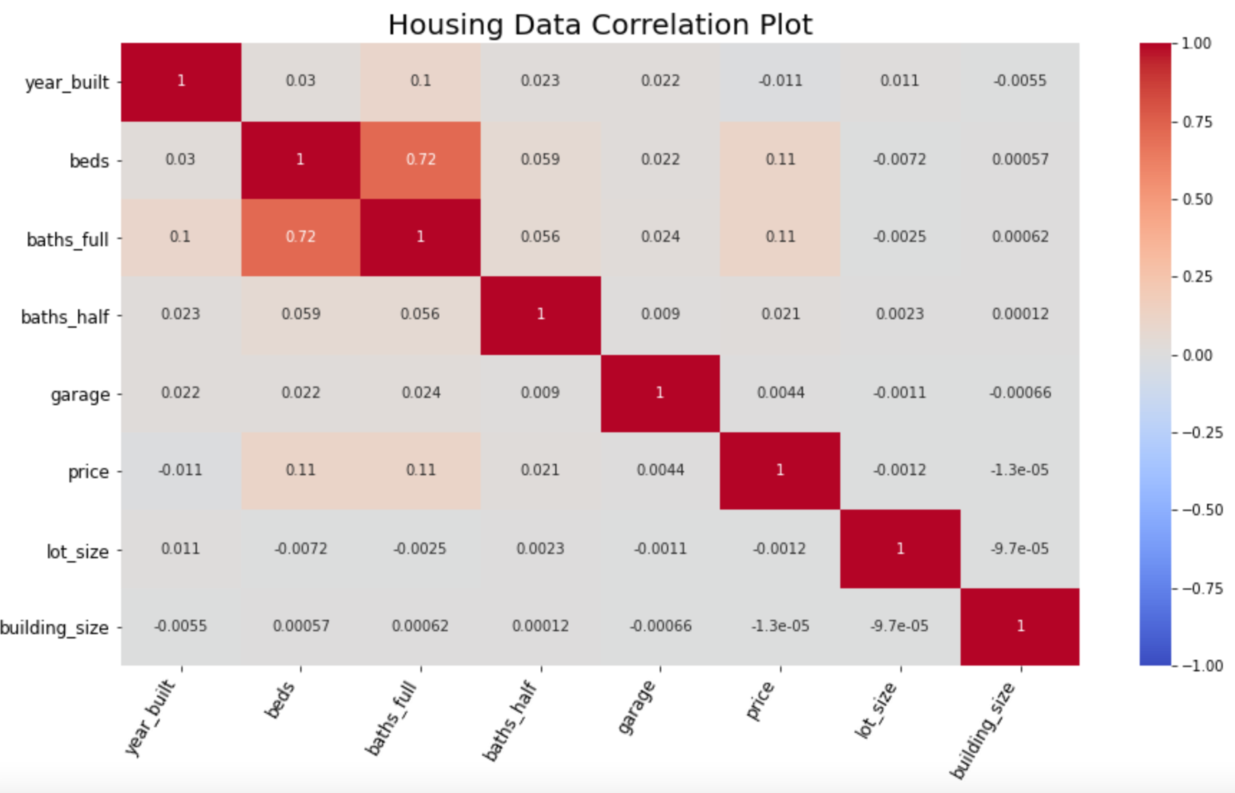
Housing Data Correlation Plot

Slide 8
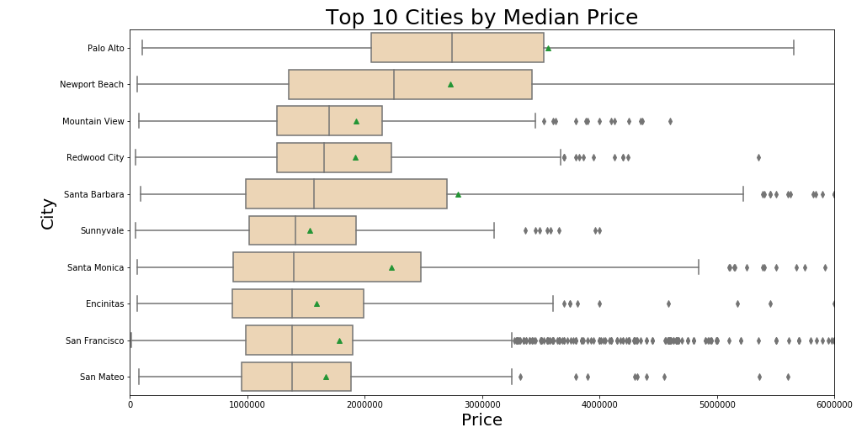
Top 10 Cities Sorted By Median Price

Slide 9
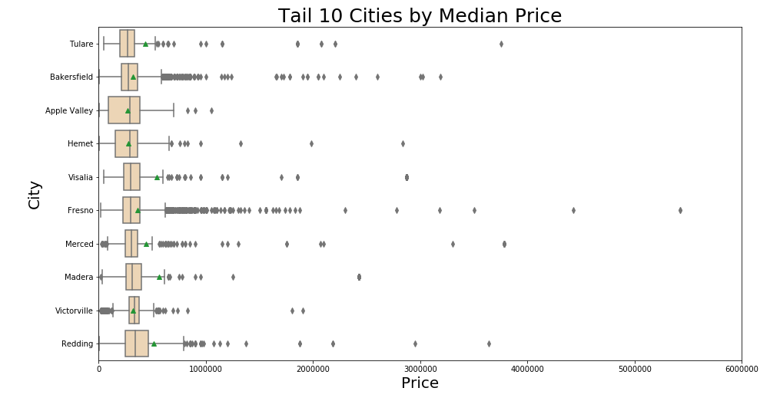
Tail 10 Cities Sorted By Median Price

Slide 10
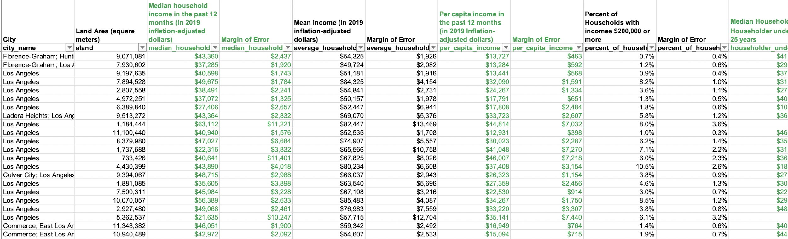
Datasets - demographic
- Median Households, Mean income, Per capital income in the past 12 months, percent of households with income more than 200,000, Median household Income by Age of Householder, age&sex and educationl level and unemployement.
Data from https://www.incomebyzipcode.com

Slide 11
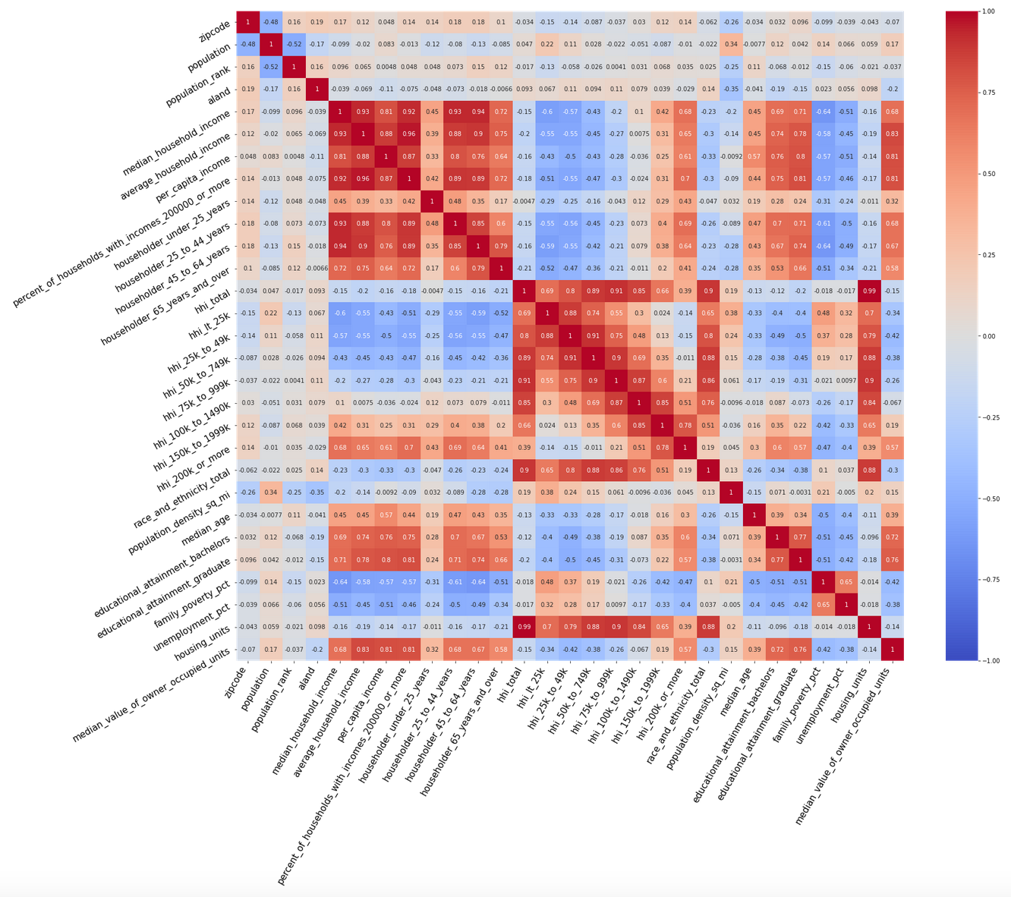
Demographic Correlation Hotplot

Slide 12
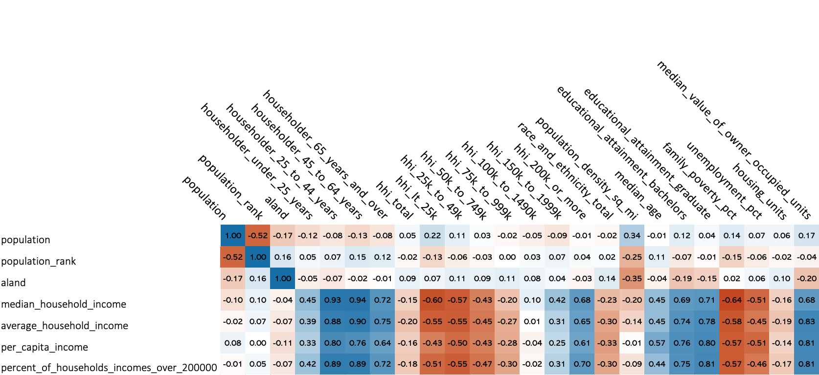

Slide 13
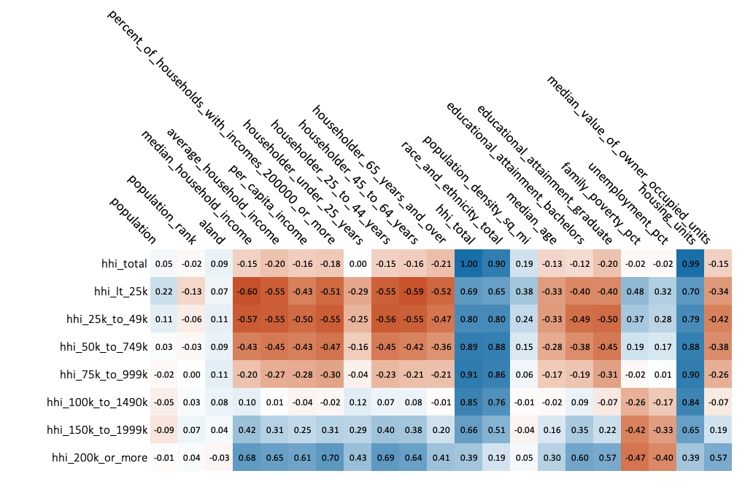

Slide 14
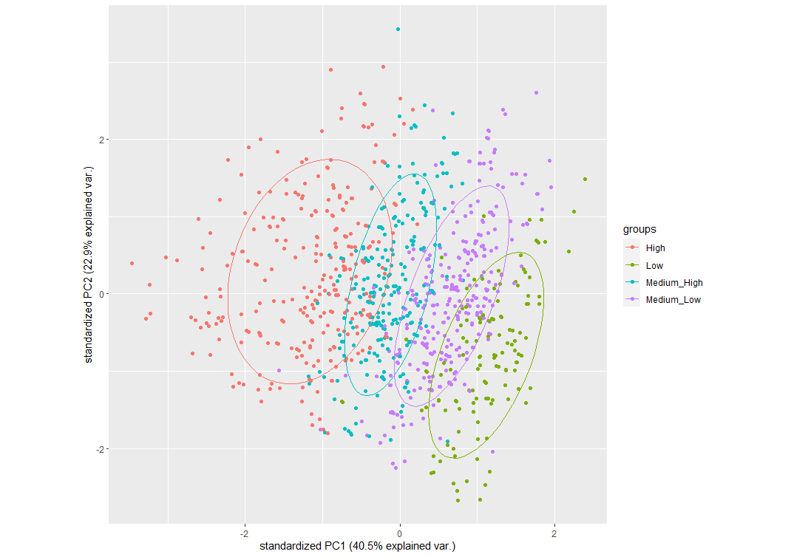
PCA plot(1st Component and 2nd Component)

Slide 15
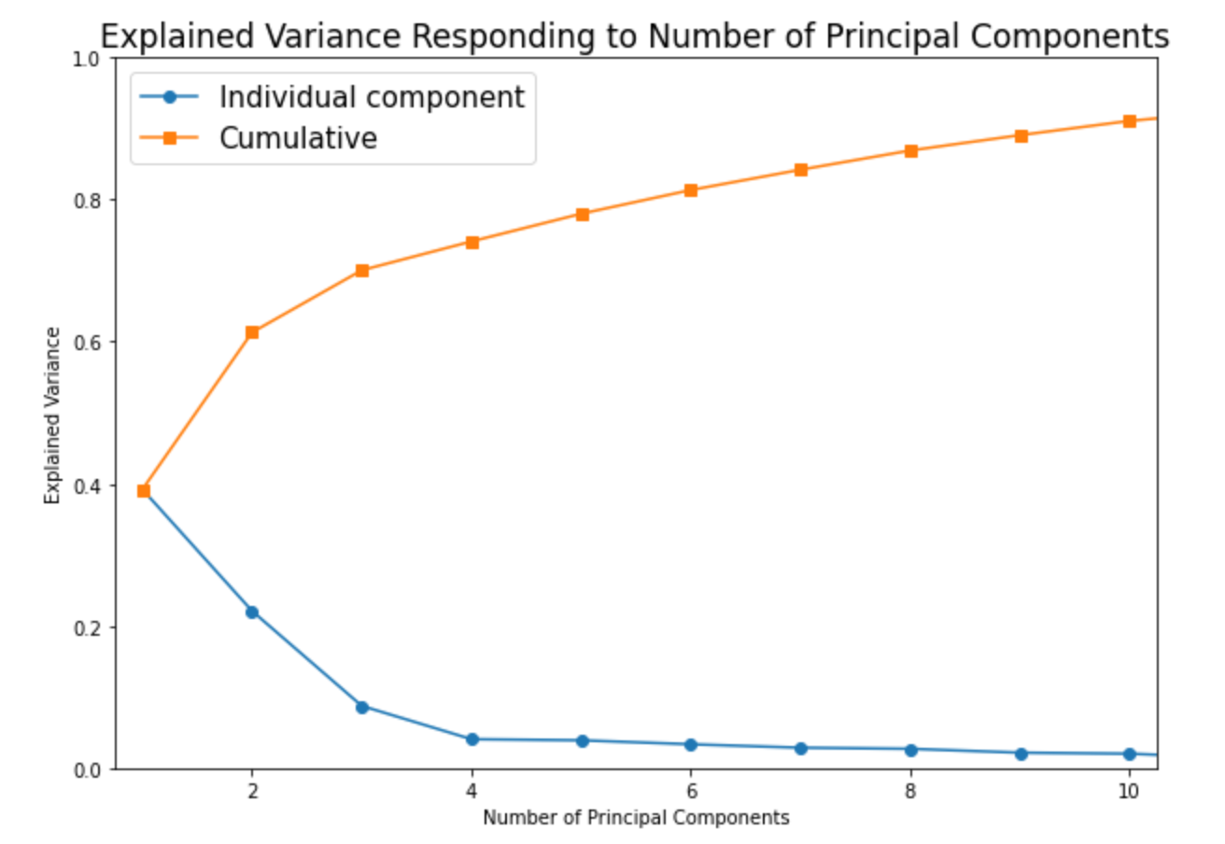
Explained Variance

Slide 16
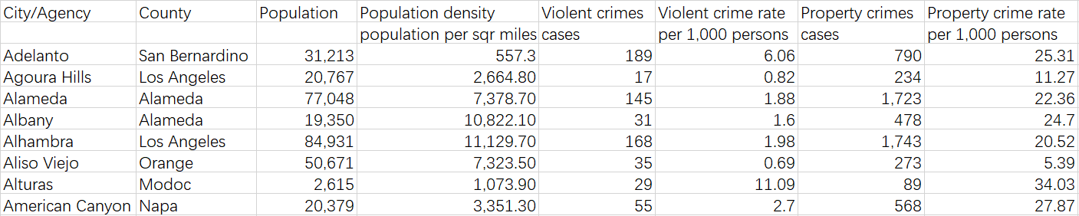
Crime Rate
Data from https://www.census.gov

Slide 17
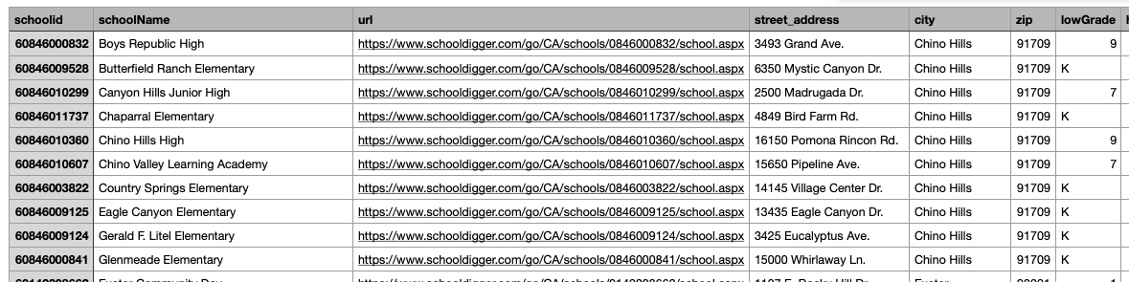
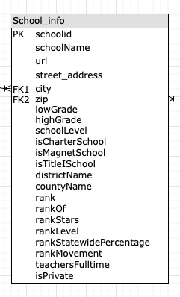
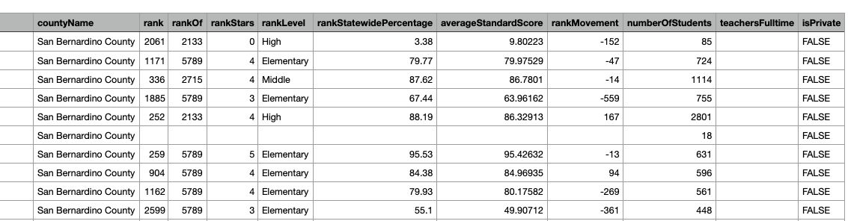
School Data
Data from SchoolDigger API

Slide 18
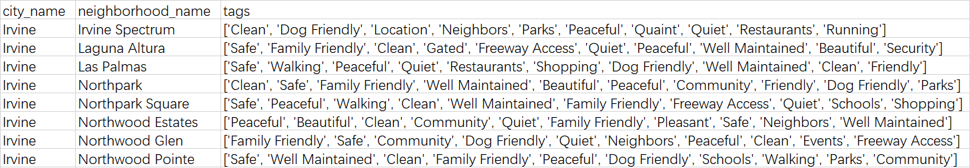
Neighborhood Data
Data from NextDoor.com

Slide 19
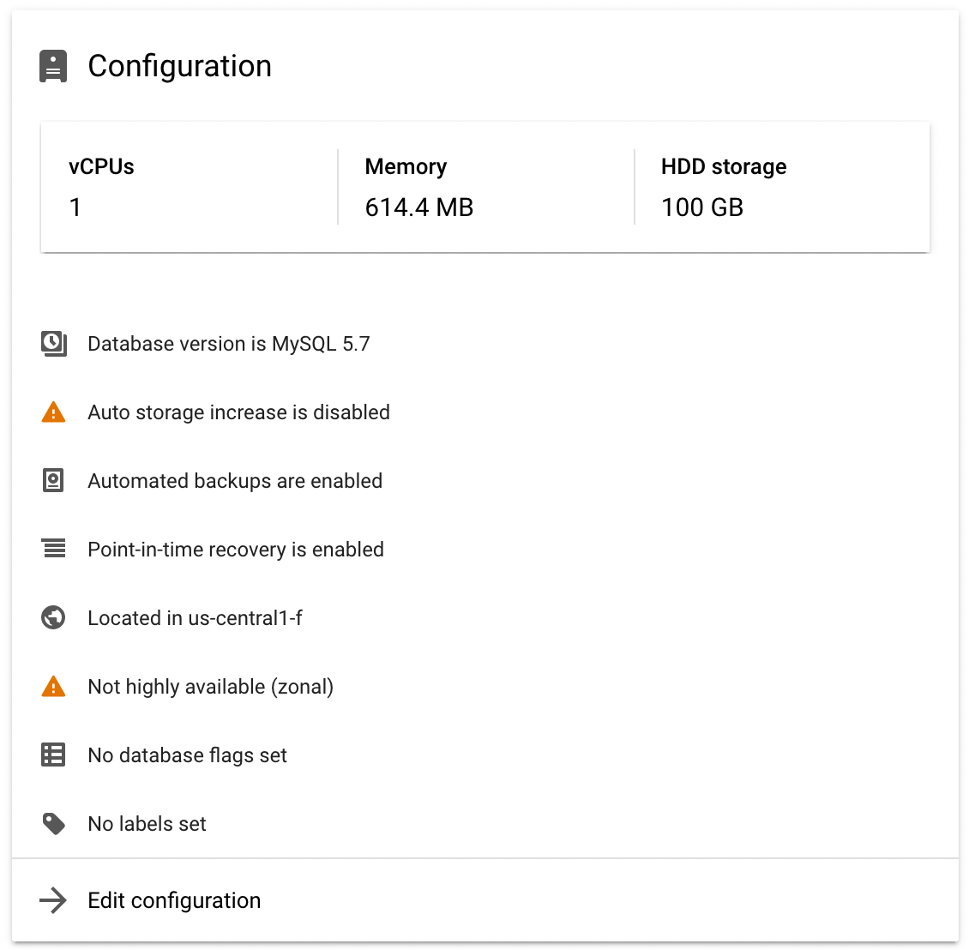
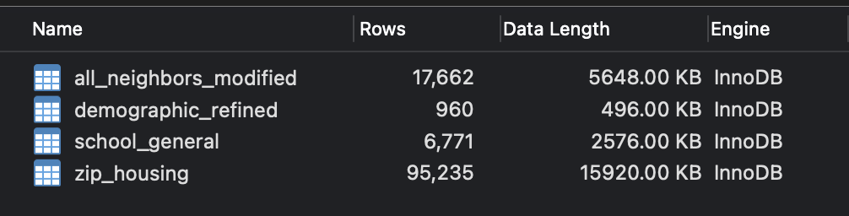
GCP Data Management

Slide 20
Timeline
Week 1: Data collection and wrangling
Week 2: Data wrangling
Week 3: Finish up data wrangling (combine columns and datasets, etc.)
Week 4: Start training and testing simple models on partial data
Week 5: Continuing training and testing other models and approaching to apply them to full-scale data
Week 6+: Finishing up the training and testing along with starting the final report draft

